Slide 1
19CSE211 Computer Architecture & Organization
Control Unit Design of Multi Cycle Data Path Implementation of MIPS Architecture-Part 4

Slide 2
Designing the Control Unit for Multi Cycle Datapath
Technique implemented:
Finite state machine

Slide 3
Performance Problem-CPI in a Multicycle CPU
Assuming the instruction mix 25% loads(1% load byte and 24% load word), 10 % stores(1% store byte and 9% store word), 11% branches(6% beq and 5% bne), 2% jumps(1% jal and 1% jump) and remaining ALU Operations.
What is the CPI, if each state in a multicycle CPU requires 1clock cycle?
What is the CPI, if all instructions take equal number of cycles ,for the above instruction mix?

Slide 4
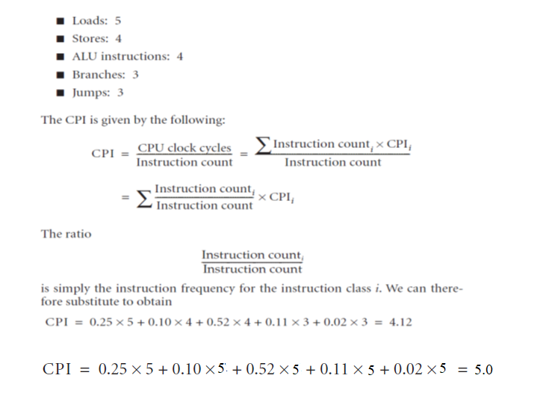
Performance Solution..

Slide 5
Abstract View of the finite state machine control
Figure:5.31

Slide 6
Instruction fetch and decode is for every instruction is the same
Figure:5.32

Slide 7
The finite state machine for controlling the memory reference instruction has four states
Figure:5.33

Slide 8
R Type Instructions can be implemented with a simple two-state finite state machine
Figure:5.34

Slide 9
Branch Instruction requires a Single State
Figure:5.35

Slide 10
Jump Instruction requires a single State
Figure:5.36

Slide 11
Complete Finite state Machine Control for the Datapath
Figure:5.38

Slide 12
Implementation of Finite State Machine
Figure:5.37

